Slide 1
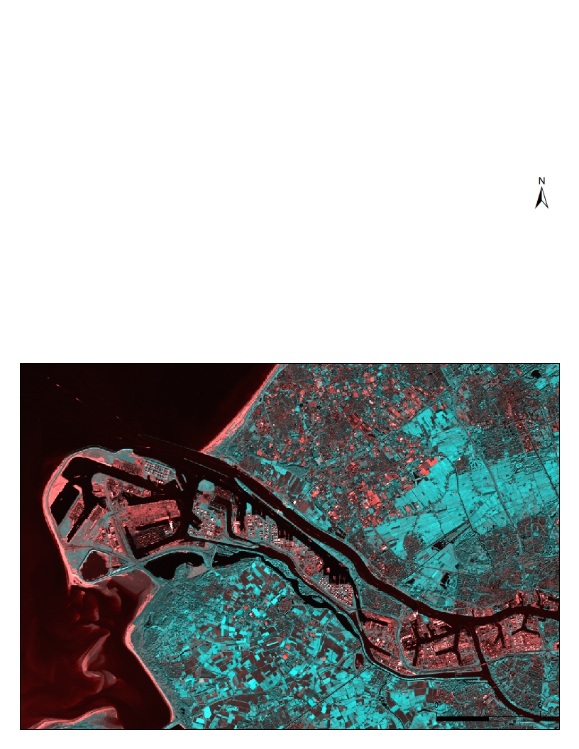

Introduction to Remote Sensing
Processing Chefchaouen province (Morocco) Landsat image
Rachid Berghout

Slide 2
1
FALSE COLOUR IMAGES
sacrifices natural color rendition in order to ease the detection of features that are not readily discernible otherwise
OUTLINE
2
NDVI
quantifies vegetation by measuring the difference between near-infrared (which vegetation strongly reflects) and red light (which vegetation absorbs).
3
UNSUPERVISED IMAGE CLASSIFICATION
Assigning land cover classes to pixels by grouping them into “clusters” based on their properties
4
SUPERVISED IMAGE CLASSIFICATION
Assigning land cover classes to pixels by selecting representative samples for each land cover class. The software then uses these “training sites” and applies them to the entire image.
Notes:
NDVI (Normalized Difference Vegetation Index)
for example the use of near infrared for the detection of vegetation in satellite images. the colour of a tärget features in the displayed image does not have any resemblance to its actual colour
mage classification is the process of assigning land cover classes to pixels

Slide 3
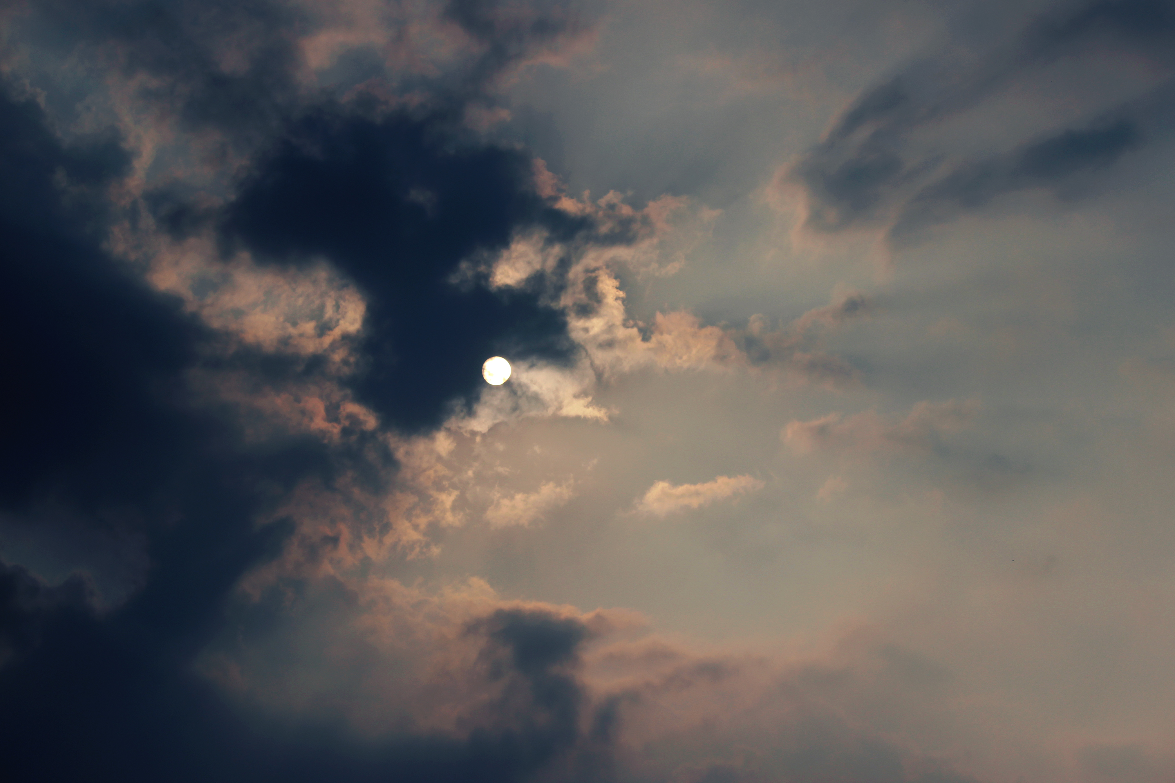
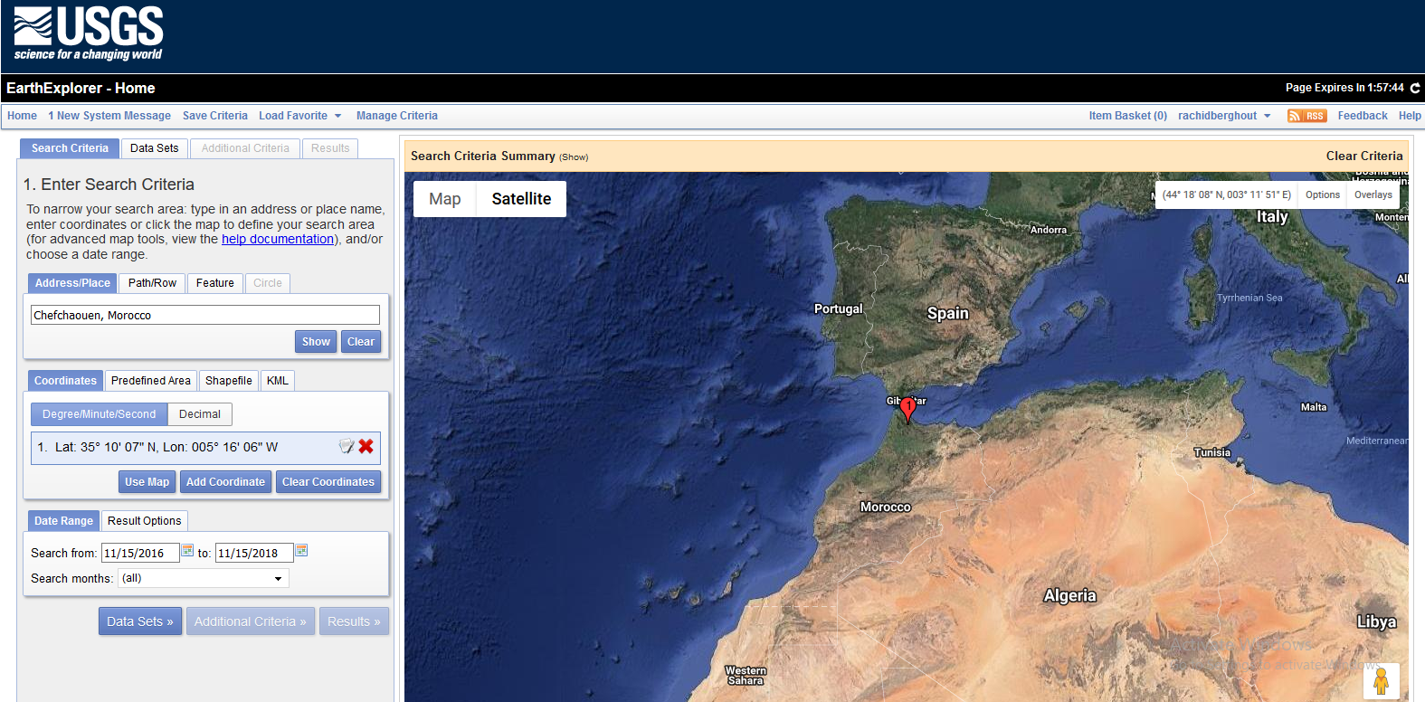
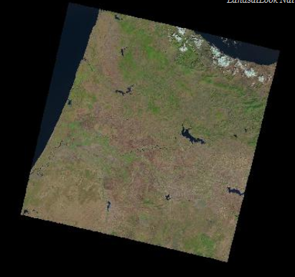
AMAZING

Slide 4
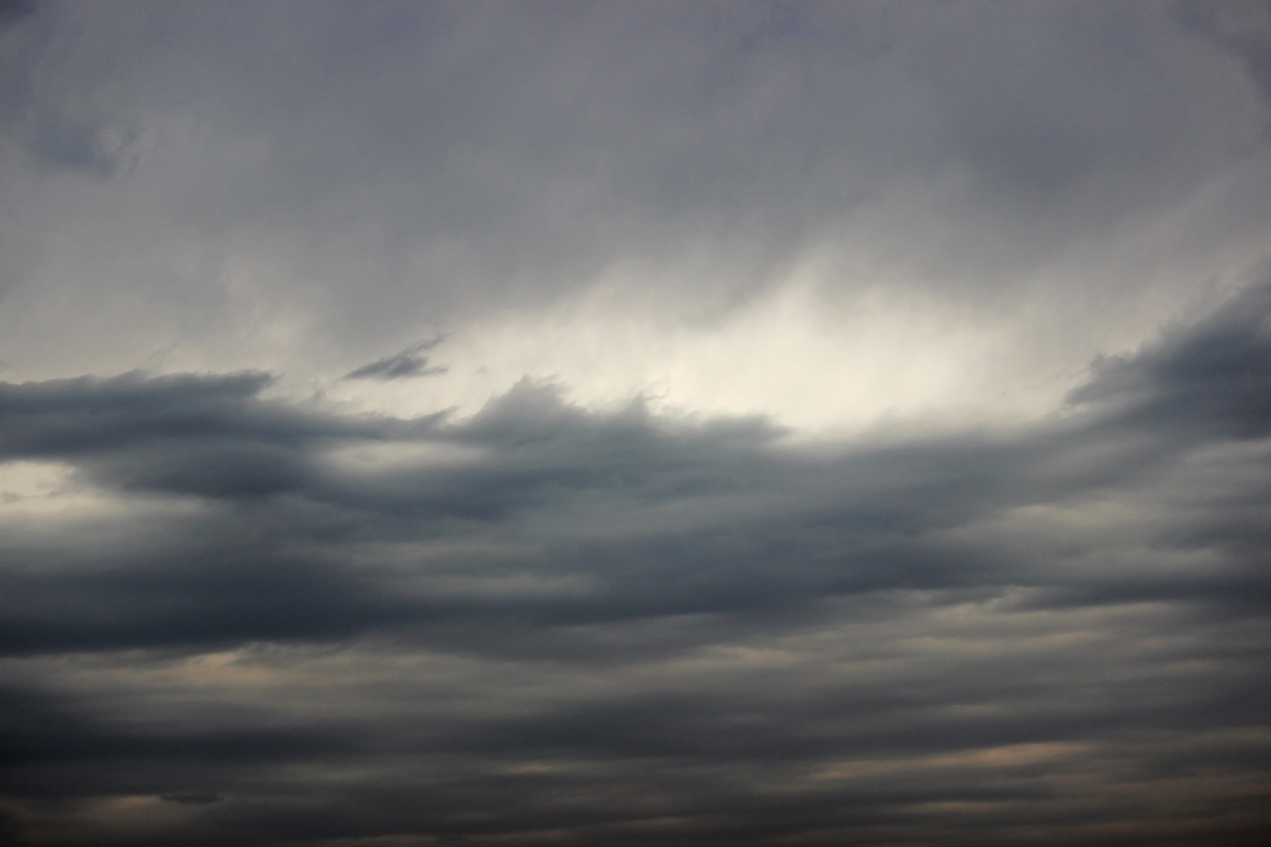
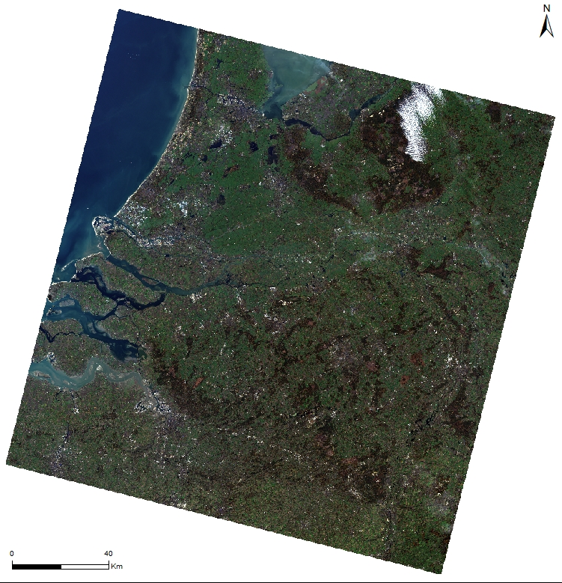
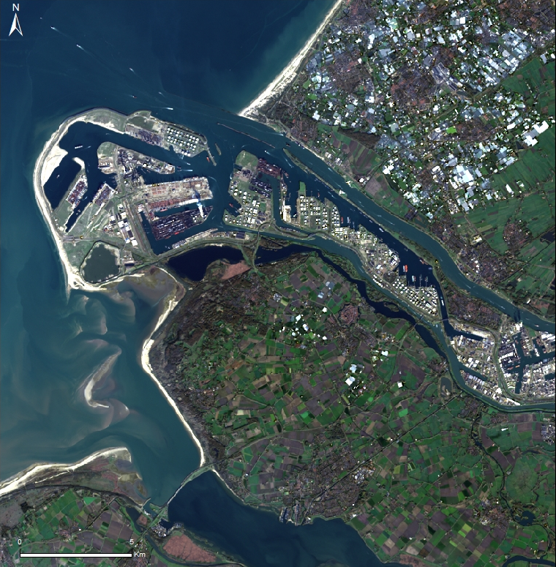
1
True Colour: Bands 4, 3, 2
Notes:
A satellite image is created by combining measurements of the intensity of certain wavelengths of light that are visible and invisible to human eyes.

Slide 5
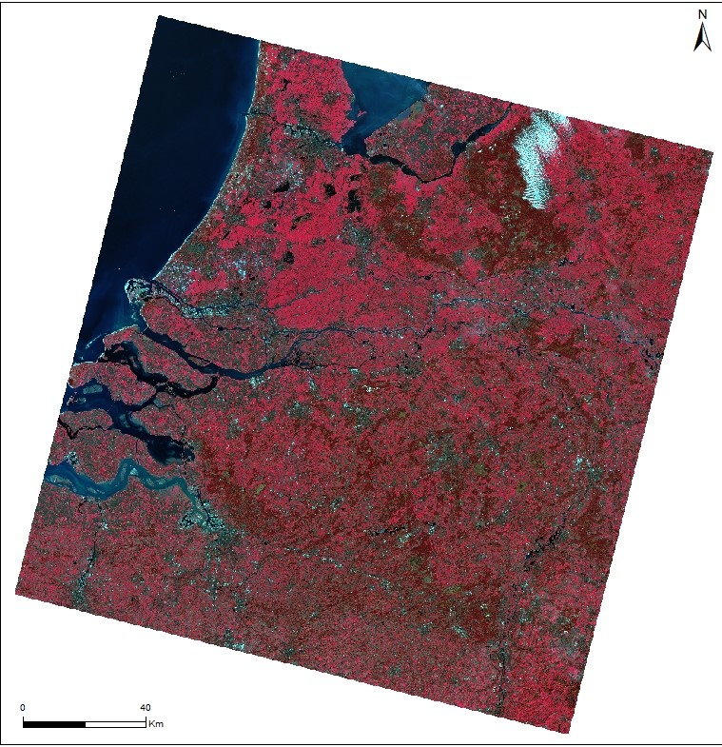
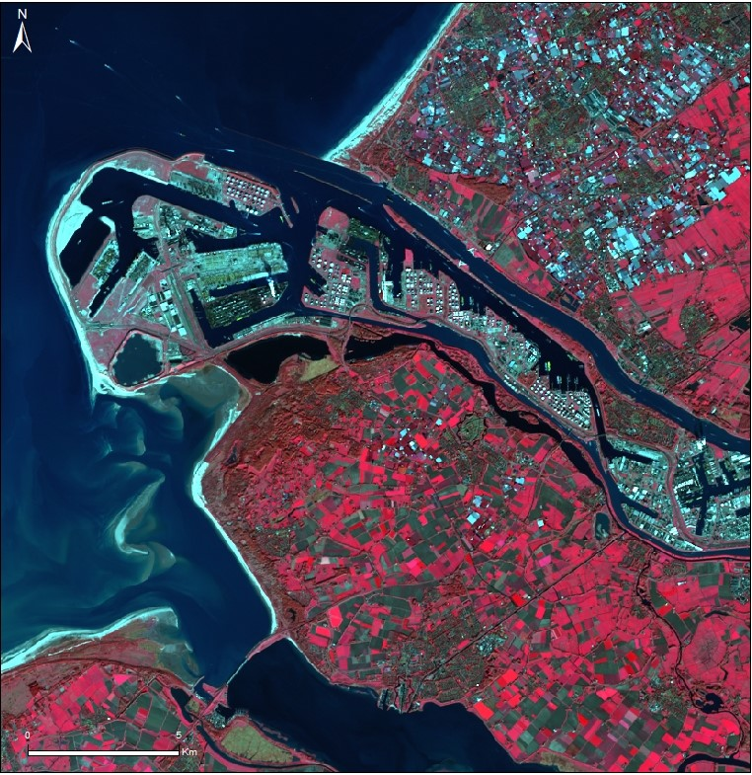
1
False colour: Bands 5, 4, 3
Notes:
A satellite image is created by combining measurements of the intensity of certain wavelengths of light that are visible and invisible to human eyes.
images made from other wavelengths of light look unnatural to us
forest be red and a cloud blue? It depends on the processes used to transform satellite measurements into images.

Slide 6
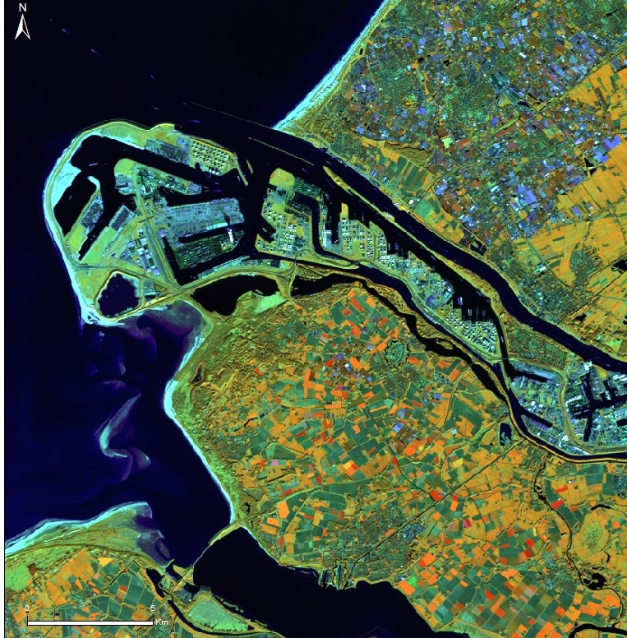
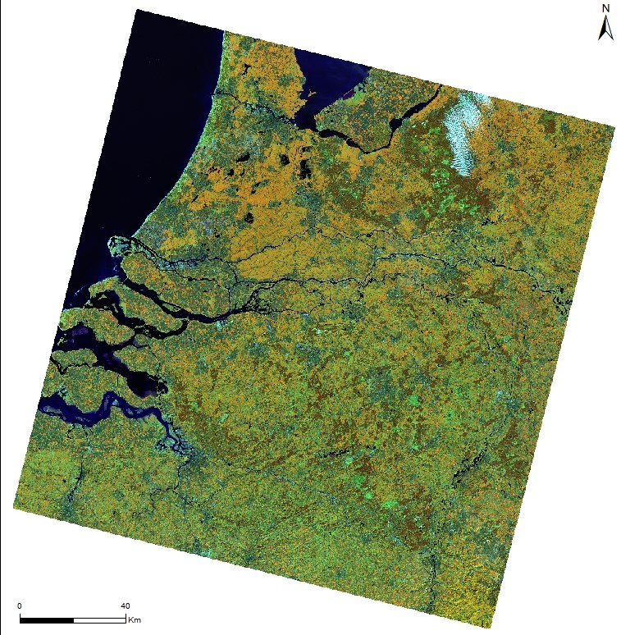
1
False colour: Bands 6, 5, 4

Slide 7
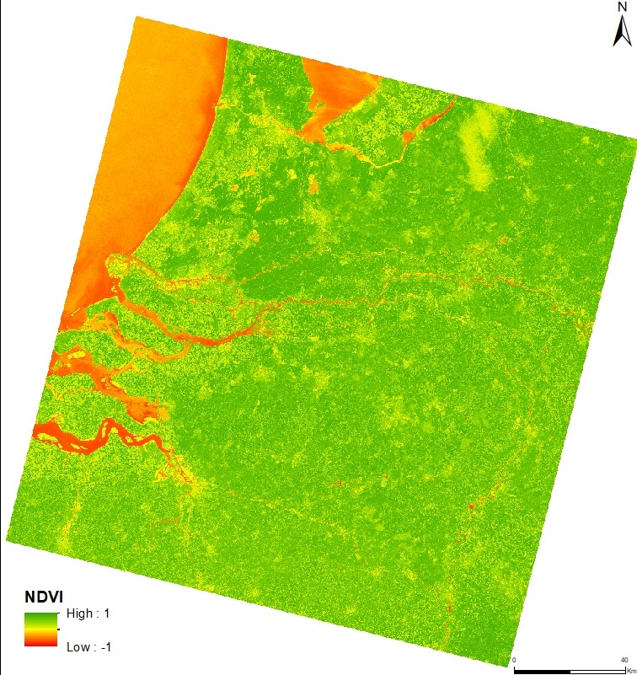
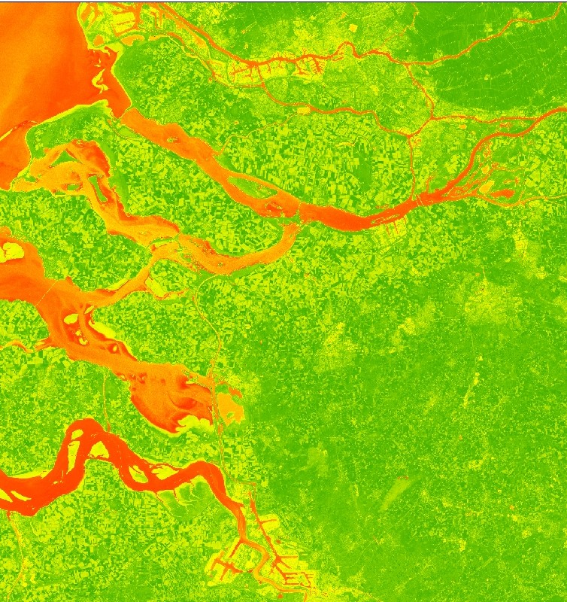
2
NDVI
Notes:
Normalized Difference Vegetation Index
quantifies vegetation by measuring the difference between near-infrared (which vegetation strongly reflects) and red light (which vegetation absorbs).
NDVI always ranges from -1 to +1. But there isn’t a distinct boundary for each type of land cover.
For example, when you have negative values, it’s highly likely that it’s water. On the other hand, if you have a NDVI value close to +1, there’s a high possibility that it’s dense green leaves
But when NDVI is close to zero, there isn’t green leaves and it could even be an urbanized area.

Slide 8
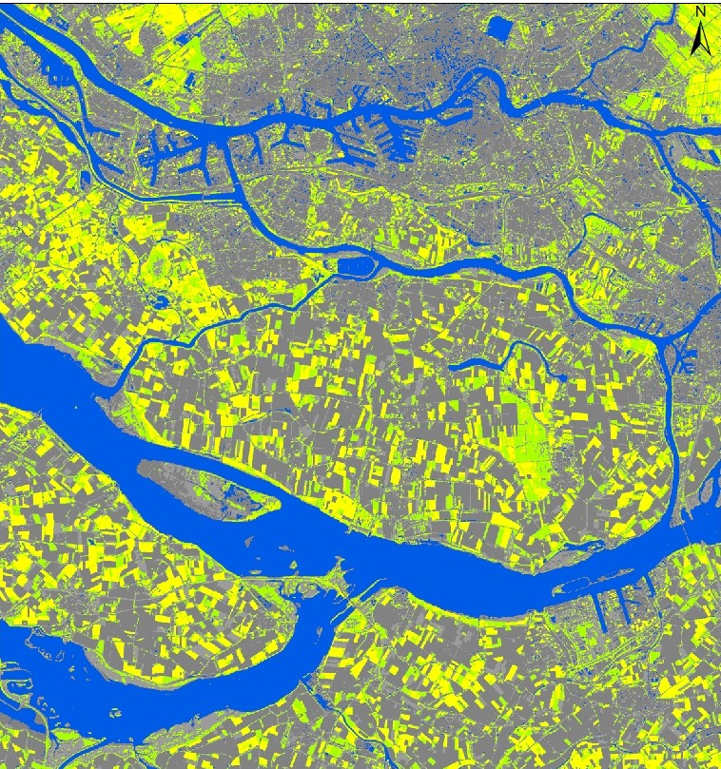
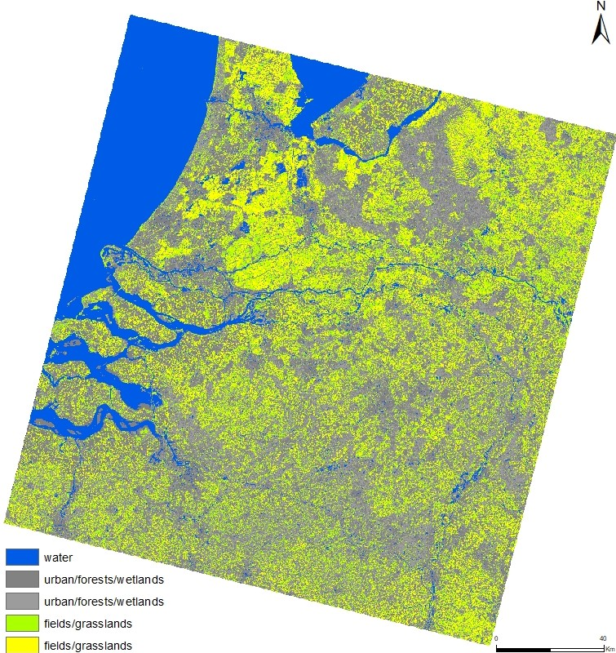
3
Isocluster unsupervised Classification

Slide 9
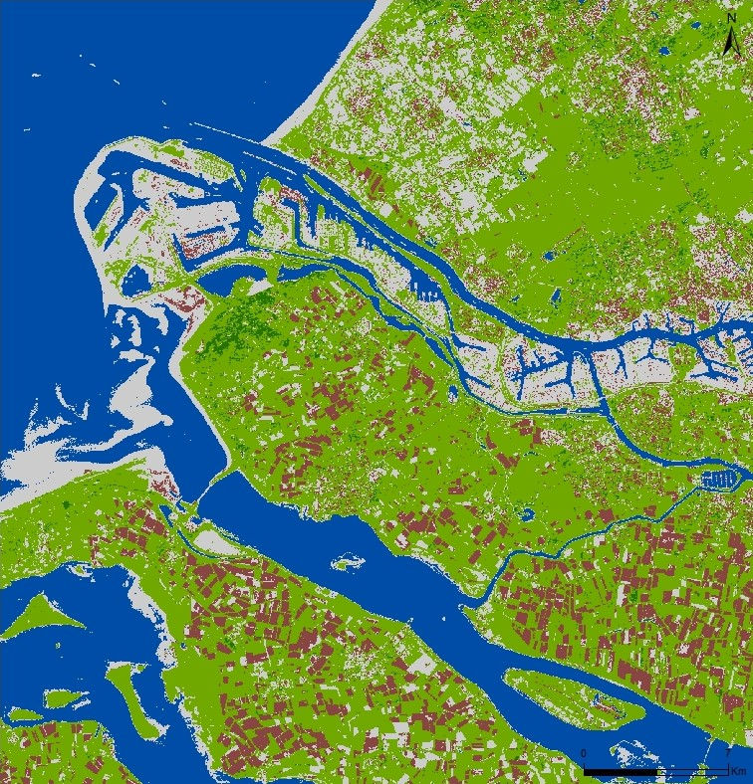
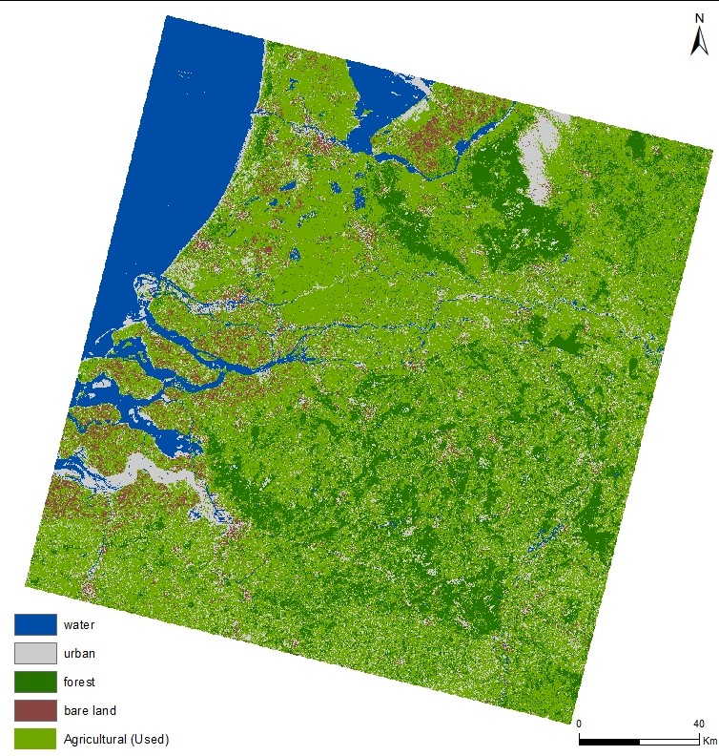
4
Supervised Classification

Slide 10
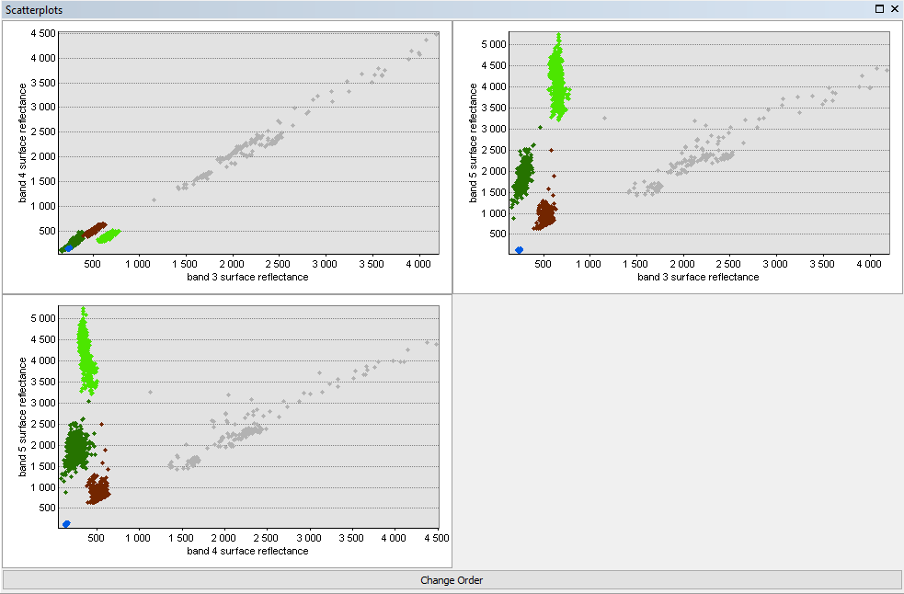
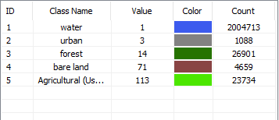

Slide 11
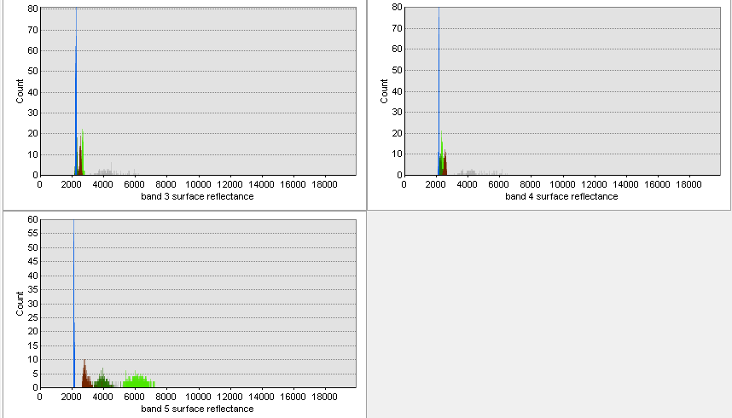

Slide 12
http://www.wikiwand.com/en/False_color
https://crisp.nus.edu.sg/~research/tutorial/opt_int.htm
https://gisgeography.com/ndvi-normalized-difference-vegetation-index/
https://gisgeography.com/image-classification-techniques-remote-sensing/
http://www.geol-amu.org/notes/m14a-4-10.htm
References

Slide 13
The End

